Slide 1
Know your User or Client

Slide 2
Designer must always do
Understand how people interact with computers.
Understand the human characteristics important in design.
Identify the user’s level of knowledge and experience.
Identify the characteristics of the user’s needs, tasks, and jobs.
Identify the user’s psychological characteristics.
Identify the user’s physical characteristics.
Employ recommended methods for gaining understanding of users.

Slide 3
Responses to Poor Design
Psychological
Physical

Slide 4
Psychological responses to poor design
Confusion
Annoyance
Frustration
Panic or stress
Boredom

Slide 5
Physical Responses to poor design
Abandonment of the system
Partial use of the system
Indirect use of the system
Modification of the task
Compensatory activity
Misuse of the system
Direct programming

Slide 6
Human Characteristics in Design
Perception
Proximity
Similarity
Matching Pattern
Succinctness
Closure
Unity
Continuity
Balance
Expectancies
Context
Signals vs Noise

Slide 7
Human Characteristics in Design
Memory
Short-term or working memory receives information from either the senses or long- term memory, but usually cannot receive both at once, the senses being processed separately. Within short-term memory a limited amount of information processing takes place.
Long-term memory contains the knowledge we possess. Information received in short-term memory is transferred to it and encoded within it, a process we call learn- ing. It is a complex process requiring some effort on our part.

Slide 8
Human Characteristics in Design
Sensory Storage
Sensory storage is the buffer where the automatic processing of information collected from our senses takes place.
It is an unconscious process, large, attentive to the environment, quick to detect changes, and constantly being replaced by newly gathered stimuli.
cocktail party affect.

Slide 9
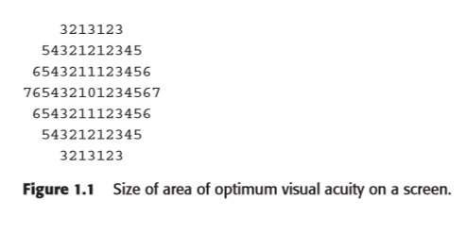
Human Characteristics in Design
Visual Acuity
The capacity of the eye to resolve details is called visual acuity.

Slide 10
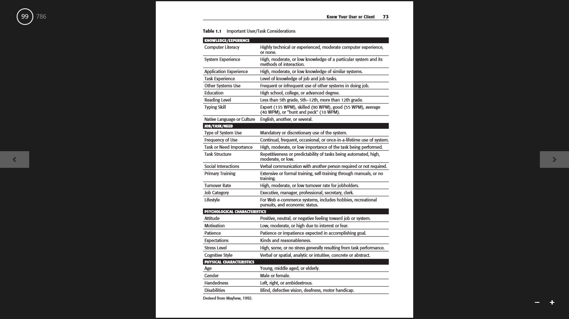
Knowledge/Experience

Slide 11
Job/Task/Need

Slide 12
Psychological Characteristics

Slide 13
Physical characteristics

Slide 14
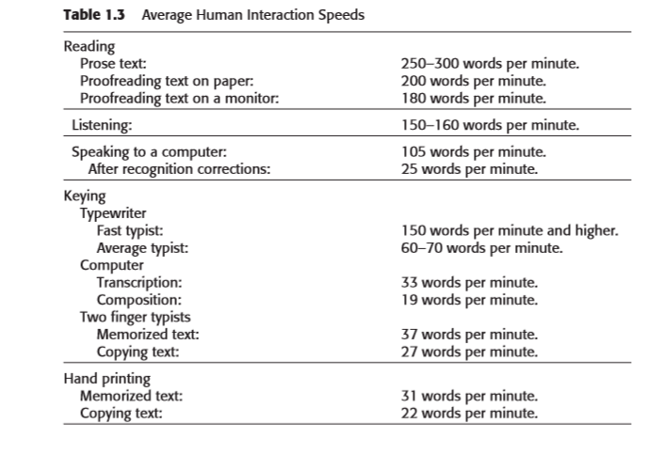
Human Interaction Speeds

